Slide 1

Phase 3:
Flight Delay Prediction
04.01.25
SECTION 3, TEAM 1
Members: Sebastian Rosales, Kenneth Hahn, Benjamin He,
Edgar Munoz, Adam Perez,
Kent Bourgoing
Notes:
AUTHOR: ADAM
Today we’ll talk through the second iteration of our distributed approach to predicting flight delays at scale.
What we wanted to explore throughout this project was two-fold:
first, can we use large-scale, real-world data to predict flight delays before they happen?
And second, can we do this in a way that’s scalable, flexible, and operationally useful?
Today, our team will walk you through the process we followed—from data sourcing and exploratory analysis, to engineering a custom pipeline and evaluating a range of models. Along the way, we’ll highlight how we iterated on experiments, where we faced challenges, and how this kind of modeling can provide real-world value.
But before we cover the new components of the project in more detail let’s re-introduce the team….

Slide 2

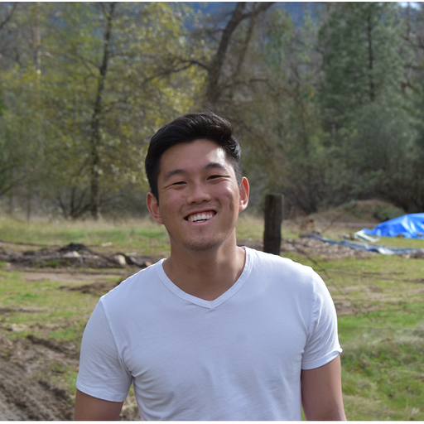




Group Members
Sebastian Rosales
sbsrosales11@berkeley.edu
Kenneth Hahn
hahnkenneth@berkeley.edu
Benjamin He
ben_he@berkeley.edu
Edgar Munoz
edgarmunoz@berkeley.edu
Adam Perez
adperez@berkeley.edu
Kent Bourgoing
kent1bp@berkeley.edu
Notes:
AUTHOR: ADAM
Our team is made up of 6 members. We have Sebastian, Kenneth, Benjamin, Edgar, Kent, and myself.

Slide 3
1.
Abstract
2.
Project Description
3.
Exploratory Data Analysis
4.
Feature Engineering
5.
Model Pipeline
6.
Model Experiments
7.
Model Results
8.
Conclusion

Slide 4
Abstract
Problem:
Flight delays are a widespread issue; our team developed a predictive model to classify departures as Early, On-Time, or Delayed using flight and weather data.
Data Sources
Combined U.S. Department of Transportation flight data with NOAA weather data; over 28 million records analyzed.
Modeling Approach
Extensive feature engineering (including PageRank for airport centrality), time-series encoding, and resampling methods to address class imbalance.
Models: Logistic Regression, Decision Tree, Random Forest, and MLP
Best Model
A Random Forest classifier with oversampling achieved the best performance (Test F1 = 54.4%) with high accuracy for Early departures.
Notes:
AUTHOR: ADAM
I want to begin by grounding us in a situation most of us have or will likely faced at one-point or another: you’re rushing through a crowded airport and finally arrive at your gate only find that your flight has been delayed. It’s frustrating—and unfortunately, it’s also incredibly common.
Our team tried to solve for this problem. We set out to build a flight delay prediction model using flight data from the U.S. Department of Transportation that was supplemented by meteorological data from NOAA. Our goal wasn’t just to build a model—but to design a scalable, robust pipeline that can anticipate delays before they happen. Our hopes were that this would enable better planning for airlines and produce less stress for passengers.
What makes this work unique to our first iteration is the depth of feature engineering and breadth of modeling architectures we explored— this included temporal encodings, airport connectivity via PageRank, and many resampling strategies to handle the class imbalance inherent in this kind of problem.
As you’ll see later, we experimented with many models and architectures. But in the end our best-performing model was a Random Forest Classifier that achieved a test F1 score of 54.4%, with strong ability for predicting early flights. It’s a promising start to solving a complex and operationally significant challenge.

Slide 5
1.
Abstract
2.
Project Description
3.
Exploratory Data Analysis
4.
Feature Engineering
5.
Model Experiments
6.
Model Pipeline
7.
Model Results
8.
Conclusion

Slide 6
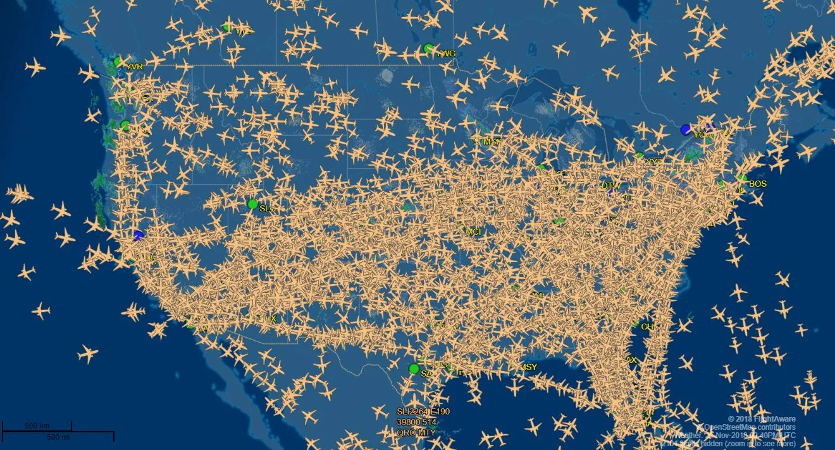
Background
Science Presentation
Air travel is a complex web of logistics that needs to be handled precisely in order to coordinate departures and arrivals for 45,000 flights and 2.9M passengers per day.
It is beneficial for both airlines and for passengers to be able to predict whether a given flight will be delayed or not for a variety of reasons:
Operational Efficiency: optimizing crew scheduling, ground handling, and gate assignments.
Customer Satisfaction: Allows for airlines to notify customers ahead of time to reduce stress and allow them to plan ahead.
Notes:
AUTHOR: ADAM
Before we dive into the new material, I want to briefly revisit the domain context we discussed in our past iteration.
As we know, air travel is a highly complex system—one that relies on very nuanced coordination across thousands of flights and millions of passengers each day. In this environment, even small delays can cascade into major disruptions.
That’s why our project focused on building a predictive model that can classify flights as early, on-time, or delayed. The potential value here is that: for airlines, it means better resource planning and operational efficiency. For passengers, it offers a more predictable and less stressful travel experience.

Slide 7
Goal
Utilizing flight data provided by the U.S. Department of Transportation and meteorological data provided by the National Oceanic and Atmospheric Administration repository (NOAA), our goal for this project is as follows:
Classify and predict flight departure times ahead of the scheduled flight to determine whether a given flight will depart early, on-time, or late.
Notes:
AUTHOR: ADAM
Since we’ve already discussed the goals and impact of this work in detail, I’ll now pass it off to Sebastian, who will do a short review on how we approached the dataset in our first iteration and what we uncovered during our exploratory analysis

Slide 8
1.
Abstract
2.
Project Description
3.
Exploratory Data Analysis
4.
Feature Engineering
5.
Model Pipeline
6.
Model Experiments
7.
Model Results
8.
Conclusion
Notes:
AUTHOR: ADAM

Slide 9
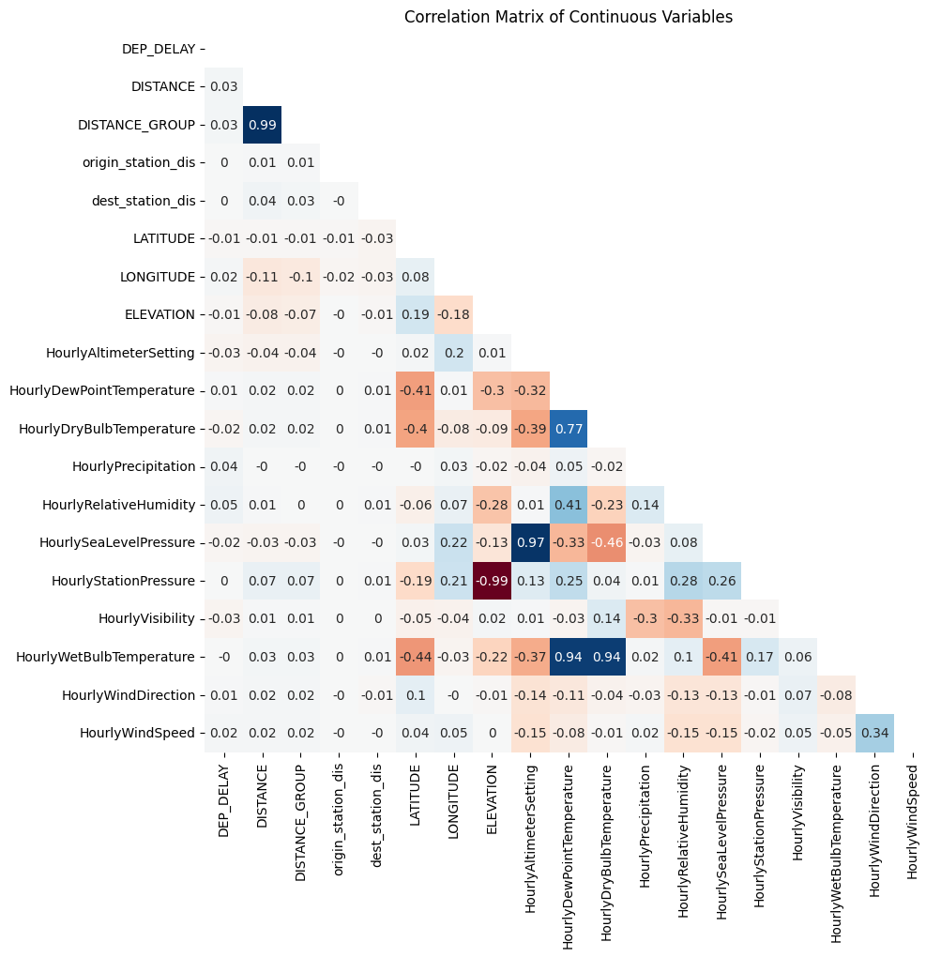
Numerical Analysis
Strong negative correlations:
ELEVATION and HourlyStationPressure
Strong positive correlations:
DISTANCE and DISTANCE_GROUP
HourlyAltimeterSetting and HourlySeaLevelPressure
HourlyDewPointTemperature, HourlyDryBulbTemperature, and HourlyWetBulbTemperature
From 3-Month to 12-Month LONGITUDE lost all of its correlation to temperature features
Notes:
AUTHOR: SEBASTIAN, PRESENTER: BEN
Our primary EDA was conducted during Phase 2,
so this’ll be a quick review of insights we gained from them.
On the right, you’ll see a correlation matrix that highlights some of the strongest correlations among features in the dataset.
Notably:
There’s a strong negative correlation between elevation and station pressure, which makes sense atmospherically—higher elevation equals lower pressure.
We also saw strong positive correlations among related weather features: for instance, Dew Point, Dry Bulb, and Wet Bulb Temperatures are tightly linked.
Another intuitive correlation is between Distance and Distance Group, a binned categorical version of the raw distance feature.
What was especially interesting is that Longitude’s correlation with temperature features degraded
when we expanded our data from a 3-month sample to the full 12-month dataset
—suggesting seasonal or geographic effects.
These insights gave us early clues about which features were potentially redundant and which ones might have predictive value.

Slide 10
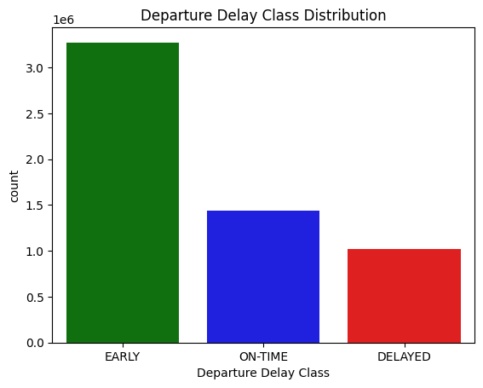
Target Variable Analysis
We are interested in classifying 3 classes
Early (Delay < 0 minutes)
On-Time (0 <= Delay <= 15 minutes)
Delayed (15 minutes < Delay)
Chose 15 minutes as Delayed based on the definition from Department of Transportation
Early is by far our majority class representing 57.2% of flights
On-Time is the second most common occurrence representing 25.1% of flights
Delayed is the rarest occurrence representing 17.8% of flights
Notes:
Discuss class imbalance from 2-class classification versus 3-class classification
AUTHOR: SEBASTIAN, PRESENTER: BEN
Now turning to the target variable—we framed our prediction task as a three-class classification problem, based on departure delay:
A flight is Early if it departs before the scheduled time.
On-Time means it departs within 0 to 15 minutes after schedule.
And Delayed includes anything with a departure delay over 15 minutes—following the Department of Transportation’s formal cutoff.
A major challenge here is the class imbalance:
‘Early’ flights make up about 57% of the data.
‘On-Time’ comes in at about 25%.
And ‘Delayed’ is our minority class, representing only 18% of cases.
This skew informed our later decision to experiment with resampling strategies
—like upsampling and SMOTE—to help the model learn from the minority classes more effectively.
In short, this early analysis was critical in guiding how we approached everything from model architecture to evaluation metrics.

Slide 11
1.
Abstract
2.
Project Description
3.
Exploratory Data Analysis
4.
Feature Engineering
5.
Model Pipeline
6.
Model Experiments
7.
Model Results
8.
Conclusion

Slide 12
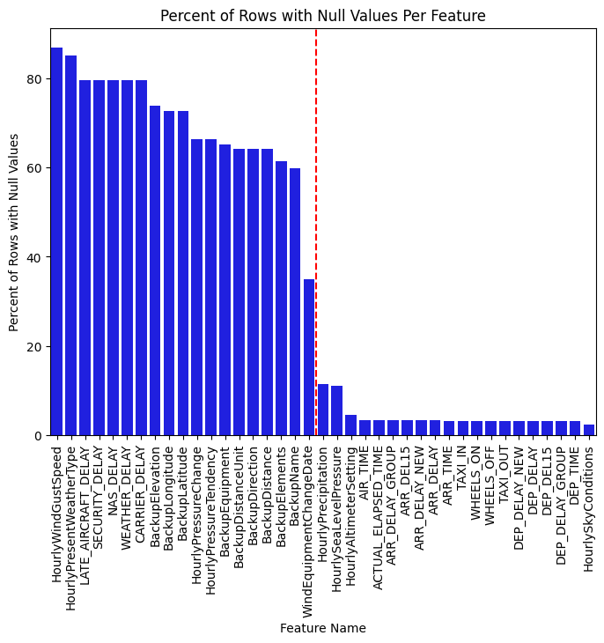
Missing Values
We filled in missing values with a new “missing” category for categorical values and filled in “0” for Hourly Precipitation (as described in the data dictionary)
For all other categories, we dropped missing values (leading to 9.65% of rows dropped).
Deemed acceptable as we still had 28M rows of data after dropping.
Notes:
AUTHOR: KENNETH

Slide 13
Graph Based Features
Create a graph utilizing the source and destination airports for each flight.
Calculated the frequency of flights between different airports (edge weights)
Compute PageRank and rejoin PageRank with the datasets to replace ORIGIN_AIPORT_ID, and DEST_AIRPORT_ID
PageRank of airports weighted by number of flights will rank relative importance of airports based on how many outgoing/incoming flights there are.
Model can thus utilize this information to better predict flight delays.
Airport DFW
Num Flights: 14246
Airport CLT
Num Flights: 14112

Slide 14
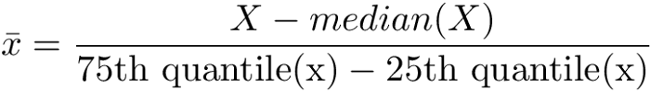
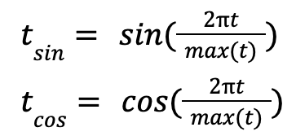
Time Series and Numeric Features
Time Series Features needing further processing: Scheduled Departure Datetime, Four Hours Before Departure Datetime, Two Hours Before Departure Datetime, Weather Station Datetime (4 hours before departure).
Extract only the hour and minute from these datetimes.
Cyclically encode temporal features.
Preserves periodicity of the features so the model can learn continuous temporal patterns (weekly, monthly, quarterly, etc)
Added benefit of keeping the range of values from [-1, 1]
Utilized for MLP as it can help predict nonlinearity of time patterns.
For Numeric Features, utilize a RobustScalar to scale all columns based on the median and interquartile range.
Notes:
AUTHOR: KENNETH

Slide 15
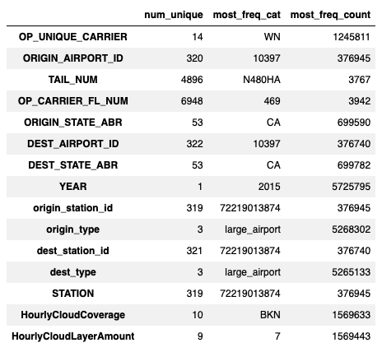
Categorical Features
High Cardinality Features (Target Encoding)
Low Cardinality Features
We defined Highly Cardinal Features as any features with > 100 unique categories.
We then grouped by each feature and calculated the mean delay time.
Rejoined it back in order to have a numeric feature instead of a one-hot encoded feature and reduced cardinality significantly.
Risk of Data Leakage with this method (Refer to later Section)
One-Hot Encoded the remaining categorical features.
Our entire Feature Space is now 221 different features (numeric + categorical features)

Slide 16

Principal Component Analysis
For one experiment, run PCA, a dimensionality reduction technique to find a lower dimensional vector(s) that maximizes the variance.
To find 2nd, 3rd, 4th, nth principal component, repeat the process but with a new vector that is also orthogonal to the other ones.
This ensures that we reduce the dimensionality while minimizing the variance loss in the data.
We used 110 principal components (50% reduction of feature space) for our testing.
Notes:
AUTHOR: KENNETH, presenter: BEN
As part of our experimentation, we explored Principal Component Analysis, or PCA, as a dimensionality reduction technique.
The idea here was to reduce the high-dimensional feature space
—over 200 features after engineering—by projecting it into a set of orthogonal vectors, each capturing the maximum possible variance in the data.
For this test, we reduced our feature set by about 50%, retaining 110 principal components.
The expectation was that this would speed up training and potentially reduce overfitting.
However, despite the intuition behind PCA, it did not lead to performance improvements in our final model evaluations.
In fact, the MLP model trained on PCA-transformed data showed slightly lower F1 scores than its non-PCA counterparts—
possibly because the transformation may have obscured some of the more interpretable, domain-specific patterns that our neural networks were relying on.
So while PCA was helpful to test, it ultimately seemed to support that feature richness is worth preserving in this context, at least for multilayer perceptrons.

Slide 17
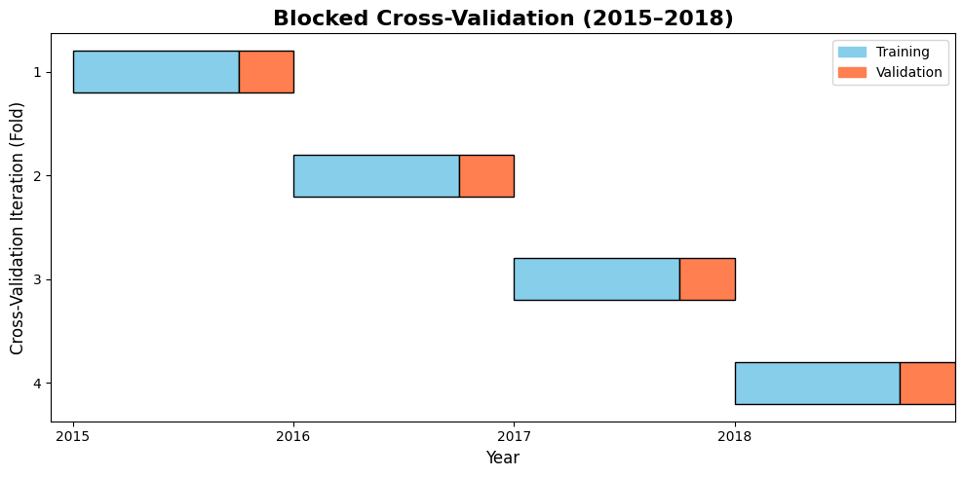
Hyperparameter Tuning
Created subsamples from each year (2015–2018) instead of only using 2015.
Each yearly fold contains ~500,000 records to keep processing manageable.
Combined folds form a CV training set that reflects multi-year temporal variability.
This method supports efficient hyperparameter tuning on a diverse, time-aware dataset.
Notes:
PRESENTER: KENT
Speaker Notes:
So in now want to explain our updated approach to hyperparameter tuning. In Phase 2 (if you recall), we only used the first three quarters of 2015 for cross-validation. In this phase, however, we generate small, representative subsets from each year (2015–2018) instead of relying solely on 2015. Each subset contains roughly 500,000 records, and we combine them to form our cross-validation training set. This method captures temporal variability while remaining computationally efficient.

Slide 18

Hyperparameter Tuning
We experimented with three hyperparameter tuning techniques:
Grid Search: Exhaustively evaluates a predefined grid of hyperparameter values.
Random Search: Samples hyperparameter combinations randomly, offering a broader exploration.
Bayesian Optimization: Uses the Optuna library to “intelligently” sample hyperparameters based on past evaluations.
Notes:
PRESENTER: KENT
Speaker Notes:
And so another idea that we want to explore is the possibility of performing three different hyperparameter tuning techniques:
Grid Search , where we exhaustively evaluate a pre-defined grid of hyperparameters. This is the method we used in Phase 2
Random Search, which samples combinations randomly to explore a broader range.
Bayesian Optimization using the Optuna library, which intelligently guides the search based on previous trial outcomes.

Slide 19
Grid vs Random vs Bayesian Search
Grid Search
In our experiments, Grid Search and Random Search both took similar runtimes (for example, exploring 9 hyperparameter combinations over a similar duration).
Random Search
It performs comparably to Grid Search in terms of runtime for the same number of evaluations.
Bayesian Search (Optuna)
Uses a probabilistic model to guide the hyperparameter search based on previous outcomes.
Each trial informs the next, allowing for more targeted exploration that often yields better metric scores.
However, because trials run sequentially (each taking roughly 10 minutes), the overall runtime is significantly longer.
Conclusion: We chose Grid Search for our project because it is straightforward to implement, leverages parallel processing, and is more runtime efficient, even though Bayesian Search may provide slightly better metric scores per trial.
Notes:
PRESENTER: KENT
Speaker Notes:
The way we determined the best hyperparameter tuning method was by testing a simple Logistic Regression model on a 3‑month subset (2015 Q1). Our goal was to assess not just how effectively each method finds the optimal hyperparameters, but also their runtime efficiency.
Grid Search: In Grid Search, we define a fixed grid of hyperparameter values and evaluate every possible combination. In our tests, we observed that Grid Search performed quite efficiently because our custom cross-validation framework allows us to run multiple parameter combinations in parallel. This means that even though we’re checking every combination, the process doesn’t take much longer than other methods when the grid is reasonably sized.
Random Search: On the other hand, Random Search works by sampling hyperparameter values at random from the defined ranges. We found that when we compared it to Grid Search—using the same number of hyperparameter evaluations—they took roughly the same runtime. However, Random Search does not guarantee that every combination is explored, which might lead to missing out on the optimal settings if the search space isn’t well-defined.
Bayesian Search (using Optuna): However, Bayesian Search is a more sophisticated method where each trial’s outcome informs the selection of the next set of hyperparameters. Essentially, it builds a probabilistic model of the hyperparameter space and sequentially chooses the parameters that are most likely to improve the model’s performance. In our experiments, Bayesian Search often produced better metric scores for each trial. However, because each trial is executed sequentially—meaning one trial has to finish before the next starts—this method takes considerably longer per trial. For instance, while Grid and Random searches could complete 9 combinations in parallel at around 16 min, each Bayesian trial might take 10 minutes, thereby increasing the overall runtime.
Conclusion: In our project, we opted to continue using Grid Search because of its simplicity and efficiency. It enables us to leverage parallel processing, making it a more practical choice compared to the slower Bayesian Search, despite the latter’s potential for yielding slightly better metric scores in a sequential, trial-by-trial manner.

Slide 20

Data Leakage
Data leakage occurs when information from outside the training set is used during model training, leading to overly optimistic performance estimates. For example, if future flight delay data is included in training, the model might learn from data that won’t be available at prediction time.
How To Avoid Data Leakage?
Robust Scaling: Fit RobustScaler on numeric features (e.g., DISTANCE, ELEVATION, HourlyWindSpeed) using only training data in each fold, then transform the test data.
PageRank: Compute the PageRank feature on training data within each fold and then transform the test data.
Categorical Target Encoding: Encode high-cardinality features (e.g., TAIL_NUM, STATION) using training data only, then apply the transformation and robust scaling to the test data.
Resampling: Optionally apply upsampling, downsampling, or SMOTE on the training data within each fold.
Avoid Training Target Variable: Exclude the DEP_DELAY variable from the final feature vector.
Use these methods uniformly when training on the complete 2015-2018 dataset.
Notes:
PRESENTER: KENT
Speaker Notes:
Let’s now move on to Data Leakage which is an important aspect to keep mind during our pipeline.
Data leakage occurs when information from the test set or future data inadvertently influences our model during training, which can lead to overly optimistic performance estimates. In our pipeline, we mainly pay special attention to preventing leakage during the cross-validation phase.
For example, when applying Robust Scaling to numerical features like DISTANCE and ELEVATION, we fit the scaler only on the training records of each fold and then transform the test records using those same parameters.
Similarly, for features such as airport PageRank (weighted by the number of flights), we compute the scaling parameters exclusively from the training label data in each fold and then apply the transformation to the corresponding test label data.
For high-cardinality categorical variables (e.g., TAIL_NUM and STATION), we perform target encoding exclusively on the training set and then apply the transformation to the test data. Since the encoded features become numerical, we subsequently use Robust Scaling to standardize them.
Our custom cross-validation class provides built-in options to apply different resampling methods, including upsampling, downsampling, or SMOTE, exclusively on the training data. This ensures that the test data remains untouched as truly unseen data while addressing class imbalance during model training.
Lastly, another important way to prevent leakage, is by not forgetting to exclude the DEP_DELAY variable from the final feature vector since it directly contains the flight delay minutes.
These measures are consistently applied throughout cross-validation and the final model training process to ensure a robust and leakage-free evaluation.

Slide 21
1.
Abstract
2.
Project Description
3.
Exploratory Data Analysis
4.
Feature Engineering
5.
Model Pipeline
6.
Model Experiments
7.
Model Results
8.
Conclusion

Slide 22
Model Pipeline - Inputs
Inputs:
~28 raw input features expanded to ~221 after feature engineering
Checkpointing:
After major transformations on our dataset, we checkpointed the dataset for experimentation with models without having to re-process with whole pipeline.
Cluster Details:
5-10 Workers
160-320 GB Memory
40-80 Cores
1 Driver
128 GB Memory, 32 Cores
Feature Family | Description | Count | Examples (Raw Features)
Temporal | Date/time related features | ~12 | YEAR, MONTH, DAY_OF_MONTH, QUARTER, sched_depart_hour_UTC, etc.
Carrier & Flight | Airline and flight identifiers | ~5 | OP_UNIQUE_CARRIER, OP_CARRIER_AIRLINE_ID, TAIL_NUM, OP_CARRIER_FL_NUM
Airport & Geography | Origin/destination airports | ~8 | ORIGIN_AIRPORT_ID, DEST_AIRPORT_ID, origin_station_id, dest_station_id, origin_type, dest_type
Weather | Weather conditions | ~10 | HourlyDewPointTemperature, HourlyRelativeHumidity, HourlyVisibility, HourlyPrecipitation, HourlyCloudCoverage, etc.
Notes:
AUTHOR: BEN
Let’s now look under the hood of our model pipeline.
Starting with inputs, we began with roughly 28 raw features, which were transformed into over 221 engineered features after preprocessing steps like encoding, scaling, and extraction.
The main feature families we used for the inputs can be seen in the table below.
These feature families were temporal, carrier and flight, airport and geography, and weather features.
Additionally, to improve workflow efficiency, we utilized checkpointing—storing intermediate datasets at key transformation stages.
This allowed us to iterate rapidly on modeling without reprocessing the full pipeline each time.
On the infrastructure side, we used a Databricks cluster with:
5–10 worker nodes, each offering up to 320 GB of RAM and up to 80 cores,
And a robust driver node with 128 GB RAM and 32 cores, which provided plenty of parallelism to process our large dataset effectively.

Slide 23
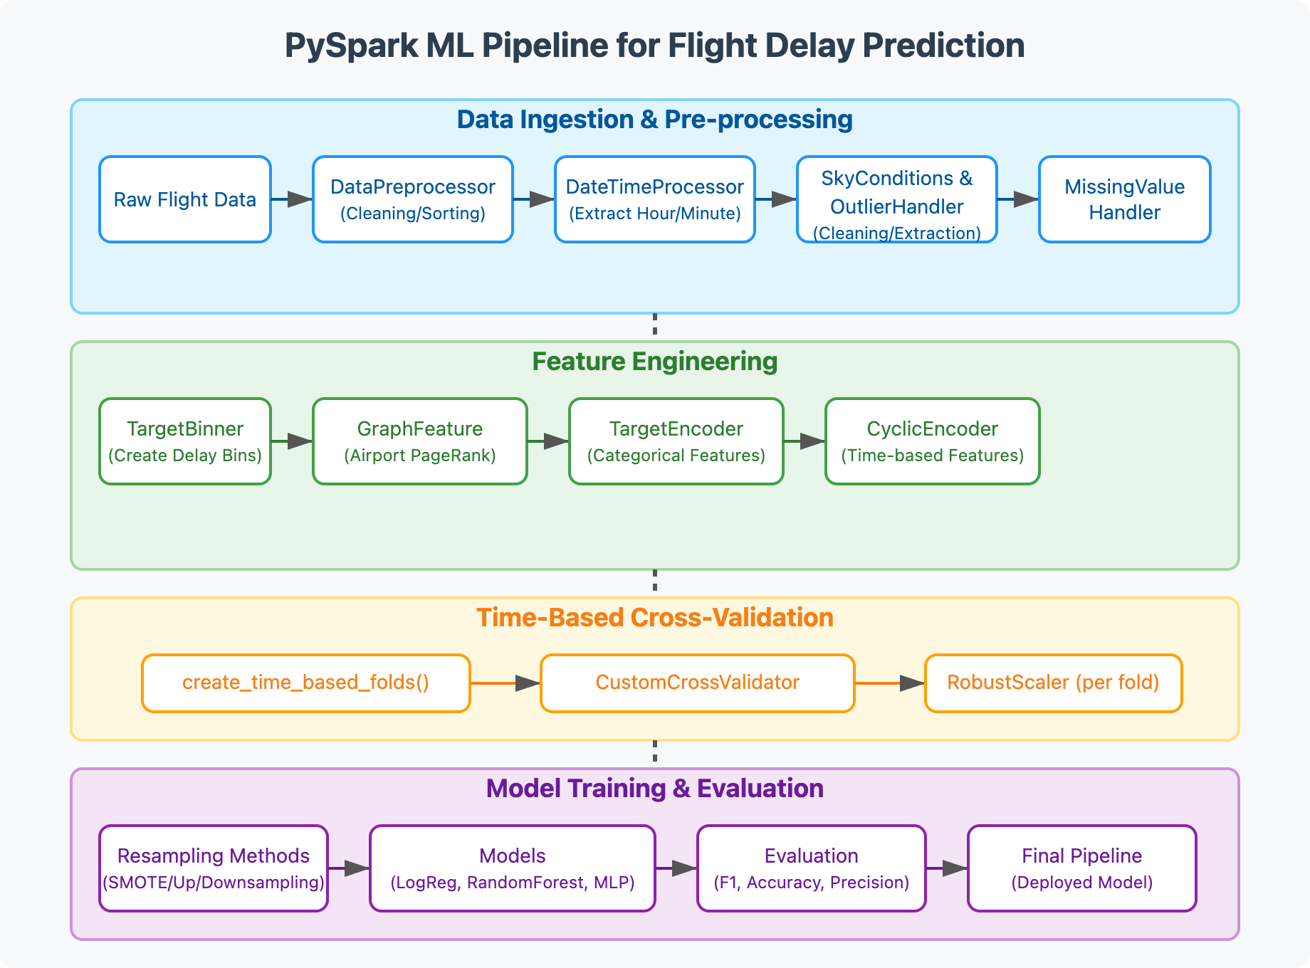
Model Pipeline - Block Diagram
Notes:
AUTHOR: BEN
Here we have our updated pipeline block diagram that highlights the high-level stages of our latest ml pipeline version.
As you can see, these stages are data ingestion and preprocessing, feature engineering, time-based cross validation,
And model training and evaluation.
More granularly, the diagram also shows the custom transformers and implemented components and methods that are used in each main stage.

Slide 24
Model Pipeline - Improvements
Refactored to be more modular for testing different models (previously hard-coded)
Additional/modified Transformers:
OutlierHandler
GraphFeature
TargetEncoder
MissingValueHandler*
Resampling capabilities for class imbalance - SMOTE, Upsampling, Downsampling
Notes:
AUTHOR: BEN
This phase significantly improved on our earlier work in Phase 2 with a much more modular design.
Previously, model choices were hard-coded—now, we abstracted components like transformers and estimators, allowing quick swaps and experiment iterations.
We also expanded the pipeline to include several custom transformers, such as:
OutlierHandler to clip extreme values,
GraphFeature to inject PageRank info,
TargetEncoder for high-cardinality categorical features, and
MissingValueHandler, which formalized our imputation logic.
We also introduced optional resampling modules like SMOTE, upsampling, and downsampling to tackle the class imbalance we showed earlier.
This full pipeline setup was designed not only for performance, but also reproducibility and flexibility in testing new ideas.

Slide 25
1.
Abstract
2.
Project Description
3.
Exploratory Data Analysis
4.
Feature Engineering
5.
Model Pipeline
6.
Model Experiments
7.
Model Results
8.
Conclusion

Slide 26

Data for Small Scale Experimentation
12 Month Dataset with Over-Sampling
For this experimentation we used a duplication over-sampling to match the majority class (Early)
Class Distribution:
Early Class: 1842967
On-Time: 1844086
Delayed: 1844551
Sequential Train/Test Split
First 80% of 2015 used for training
Last 20% of 2015 used for testing
Notes:
AUTHOR: Sebastian

Slide 27
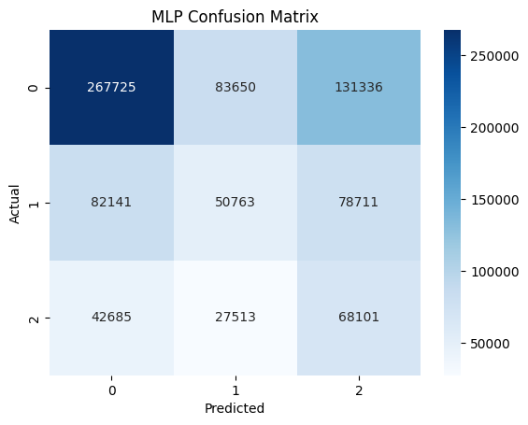
MLP Classifier (Experiment 1)
Architecture
Results:
6 layers:
Input layer: 189 features
1st hidden layer: 100 neurons
2nd hidden layer: 50 neurons
3rd hidden layer: 25 neurons
4th hidden layer: 10 neurons
Output layer: 3 classes
Training:
Accuracy: 44.65%
Weighted Precision: 43.94%
F1 Score: 43.61%
Test:
Accuracy: 46.43%
Weighted Precision: 51.57%
F1 Score: 47.81%
Notes:
AUTHOR: Sebastian

Slide 28
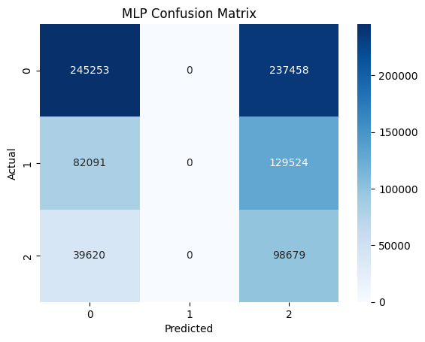
MLP Classifier (Experiment 2)
Architecture
Results:
7 layers:
Input layer: 189 features
1st hidden layer: 150 neurons
2nd hidden layer: 75 neurons
3rd hidden layer: 50 neurons
4th hidden layer: 25 neurons
5th hidden layer: 10 neurons
Output layer: 3 classes
Training:
Accuracy: 41.75%
Weighted Precision: 28.19%
F1 Score: 33.22%
Test:
Accuracy: 41.31%
Weighted Precision: 42.26%
F1 Score: 38.90%
Notes:
AUTHOR: Sebastian

Slide 29
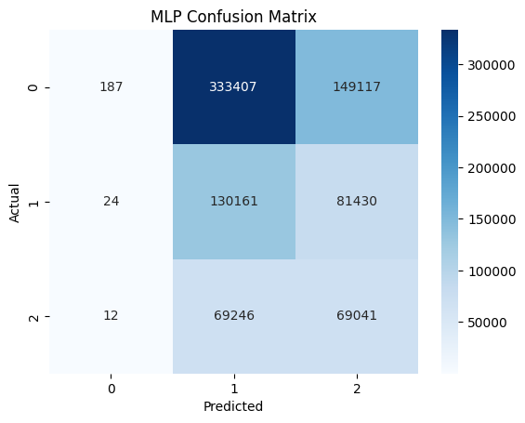
MLP Classifier (Experiment 3)
Architecture
Results:
5 layers:
Input layer: 189 features
1st hidden layer: 150 neurons
2nd hidden layer: 75 neurons
3rd hidden layer: 20 neurons
Output layer: 3 classes
Training:
Accuracy: 37.66%
Weighted Precision: 46.54%
F1 Score: 30.28%
Test:
Accuracy: 23.95%
Weighted Precision: 58.65%
F1 Score: 14.17%
Notes:
AUTHOR: Sebastian

Slide 30
1.
Abstract
2.
Project Description
3.
Exploratory Data Analysis
4.
Feature Engineering
5.
Model Pipeline
6.
Model Experiments
7.
Model Results
8.
Conclusion

Slide 31
Phase 2 Model Comparisons Across Evaluation Metrics
Model | Train F1 | Train Precision | Train Recall | Train Accuracy | Test F1 | Test Precision | Test Recall | Test Accuracy
Decision Tree (Baseline) | 0.470 | 0.445 | 0.570 | 0.570 | 0.505 | 0.460 | 0.586 | 0.586
Logistic Regression | 0.520 | 0.525 | 0.582 | 0.582 | 0.537 | 0.523 | 0.561 | 0.561
Random Forest | 0.4240 | 0.4492 | 0.5762 | 0.5762 | 0.4461 | 0.3562 | 0.5968 | 0.5968
Random Forest (with Lasso Feature Selection) | 0.4490 | 0.4935 | 0.5715 | 0.5715 | 0.4597 | 0.4297 | 0.5958 | 0.5958
Notes:
AUTHOR: EDGAR

Slide 32
Phase 3 Model Comparisons Across Evaluation Metrics
Model | Train F1 | Train Precision | Train Recall | Train Accuracy | Test F1 | Test Precision | Test Recall | Test Accuracy
Logistic Regression w/under-sampling | 0.450 | 0.451 | 0.455 | 0.455 | 0.493 | 0.537 | 0.479 | 0.479
Logistic Regression w/over-sampling | 0.461 | 0.470 | 0.481 | 0.481 | 0.542 | 0.545 | 0.550 | 0.553
Random Forest w/under-samping | 0.545 | 0.552 | 0.550 | 0.550 | 0.500 | 0.545 | 0.480 | 0.480
Random Forest w/ over-sampling | 0.446 | 0.476 | 0.483 | 0.483 | 0.544 | 0.543 | 0.575 | 0.575
MLP 1 w/ under-sampling | 0.454 | 0.460 | 0.462 | 0.462 | 0.503 | 0.548 | 0.488 | 0.488
MLP 2 w/ under-sampling | 0.442 | 0.452 | 0.457 | 0.457 | 0.502 | 0.542 | 0.491 | 0.491
MLP 1 w/ over-sampling | 0.456 | 0.469 | 0.481 | 0.481 | 0.539 | 0.543 | 0.549 | 0.549
MLP 2 w/ over-sampling | 0.384 | 0.465 | 0.471 | 0.471 | 0.491 | 0.538 | 0.541 | 0.541
MLP 1 w/ over-sampling and PCA | 0.455 | 0.467 | 0.479 | 0.479 | 0.534 | 0.542 | 0.547 | 0.547
Notes:
AUTHOR: EDGAR

Slide 33

Phase 3 Hyperparameters
Model | Hyperparameters
Logistic Regression | maxIter=300, regParam=0.10, elasticNetParam=0.0
Random Forest w/under-sampling | numTrees=20, maxDepth=15
Random Forest w/over-sampling (Best Model) | numTrees=15, maxDepth=10
MLP 1 and 2 | maxIter=50, StepSize=0.05
Notes:
AUTHOR: EDGAR

Slide 34
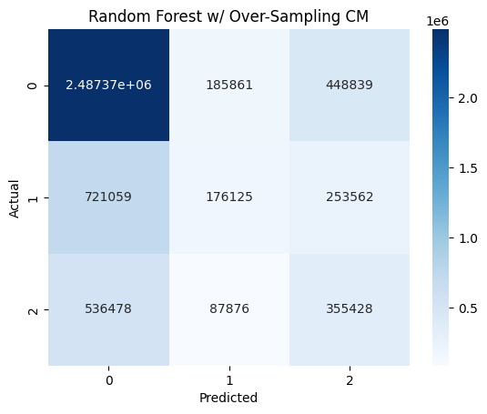
Best Model (RF w/ Over-Sampling)
Individual Class Metrics:
Early:
Precision: 66.42%
Recall: 79.67%
On-Time:
Precision: 39.15%
Recall: 15.31%
Delayed:
Precision: 33.59%
Recall: 36.28%
Even with class balancing techniques we still struggled with predicting the On-Time and Delayed classes
Notes:
AUTHOR: EDGAR

Slide 35
1.
Abstract
2.
Project Description
3.
Exploratory Data Analysis
4.
Feature Engineering
5.
Model Pipeline
6.
Model Experiments
7.
Model Results
8.
Conclusion

Slide 36
Conclusion
Designed for Scalability:
Built a distributed, modular pipeline with strong data leakage prevention (e.g., fold-specific transformations, target encoding isolation).
Compared multiple hyperparameter tuning strategies (Grid Search, Random Search, and Bayesian Optimization) to balance performance with runtime efficiency.
Best Model:
Our Random Forest classifier with oversampling achieved the best performance (Test F1 = 54.4%) with high accuracy for Early departures (the majority class).
Performance Gaps:
Class imbalance remains a key challenge—strong performance for Early, but On-Time and Delayed classes need improvement.
Operational Value:
Despite prediction challenges for on-time and delayed classes, early classifications from this model still have the potential to improve crew scheduling, gate planning, and customer communication.
Notes:
AUTHOR: ADAM
To wrap things up, I want to highlight a few key takeaways from our work on this project.
First, we built more than just a model—we built a flexible, distributed pipeline with a modular design that helped us to quickly and iteratively tackle common issues like data leakage. That infrastructure allowed us to iterate quickly on multiple hyperparameter tuning and time-fold cross validation strategies to scale efficiently and maintain efficacy in our results.
Second, while we saw strong predictive power for the majority class “early departures”, the model still struggles with the more nuanced on-time and delayed classes—most likely due to the imbalanced datasets. That’s a challenge we’ll need to address further, likely by incorporating additional operational data or moving toward real-time signal inputs.
Third, there is still practical value here: even moderately accurate early predictions can help airlines optimize resources and enhance the passenger experience.

